Slide 1

Gayatri vidya parishad college of engineering(a) Department of computer science engineering Gender and age classification using machine learning
Project done by:
Abhi Achalla (17131A0502)

Slide 2
Table of contents
Abstract
Introduction
Technologies used
Flowchart
Procedure
Applications
Output
Conclusion
Future Scope

Slide 3
ABSTRACT
Automatic gender and age classification has become quite relevant in the rise of social media platforms. However, the existing methods have not been completely successful in achieving this. Through this project, an attempt has been made to determine the gender and age based on a frame of the person. This is done by using deep learning, OpenCV which is capable of processing the real-time frames. This frame is given as input and the predicted gender and age are given as output. It is difficult to predict the exact age of a person using one frame due the facial expressions, lighting, makeup and so on so for this purpose various age ranges are taken, and the predicted age falls in one of them. The Adience dataset is used as it is a benchmark for face photos and includes various real-world imaging conditions like noise, lighting etc.
Keywords: Deep learning, OpenCV, Adience, gender detection, age determination

Slide 4
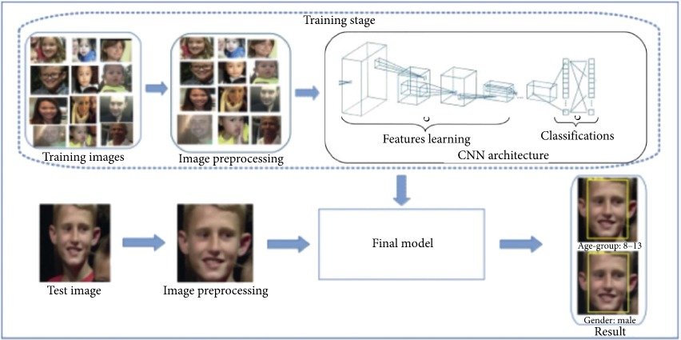
introduction
Age and gender, two of the key facial attributes, play a very foundational role in social interactions, making age and gender estimation from a single face frame is an important task in intelligent applications, such as access control, human-computer interaction, law enforcement, marketing intelligence and visual surveillance, etc.
In this project, a frame is taken as input and the algorithm will determine the age and gender of person(s) in the frame. We divide the age into 8 ranges[ (0 – 2), (4 – 6), (8 – 12), (15 – 20), (25 – 32), (38 – 43), (48 – 53), (60 – 100)] and the output age will fall into one of them. While, the gender will be either male or female.

Slide 5

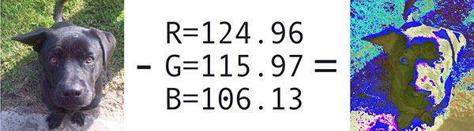
Technologies used
OpenCV
OpenCV is Open Source Computer vision. This library is capable of processing real-time frame and video while also boasting analytical capabilities. OpenCV is used to display text on the picture using putText(). Imshow() is used for the frame output. The cv2.dnn.blobFromframe function returns a blob which is our input frame after mean subtraction, normalizing, and channel swapping..
Features of OpenCV Library : MEAN SUBTRACTION USING blobFromImage() OF OpenCV
Using OpenCV library, you can −
Read and write frames
Capture and save videos
Process frames (filter, transform)
Perform feature detection
Detect specific objects such as faces, eyes, cars, in the videos or frames.
Analyze the video, i.e., estimate the motion in it, subtract the background, and track objects in it.
OpenCV was originally developed in C++. In addition to it, Python and Java bindings were provided. OpenCV runs on various Operating Systems such as windows, Linux, OSx, FreeBSD, Net BSD, Open BSD, etc.
The readNet() method to load the networks. The first parameter holds trained weights and the second carries network configuration
2. Convolutional Neural Network(CNN): A Convolutional Neural Network is a deep neural network (DNN) widely used for the purposes of frame recognition and processing and NLP. The convolutional neural network for this python project has 3 convolutional layers:
Convolutional layer; 96 nodes, kernel size 7
Convolutional layer; 256 nodes, kernel size 5
Convolutional layer; 384 nodes, kernel size 3
It has 2 fully connected layers, each with 512 nodes, and a final output layer of softmax type.
3. TensorFlow: TensorFlow is the second machine learning framework that Google created and used to design, build, and train deep learning models. To train our model we have used 2 files(.pb and .pbtxt), which are TensorFlow files. Our project uses TensorFlow in the back-end.

Slide 6
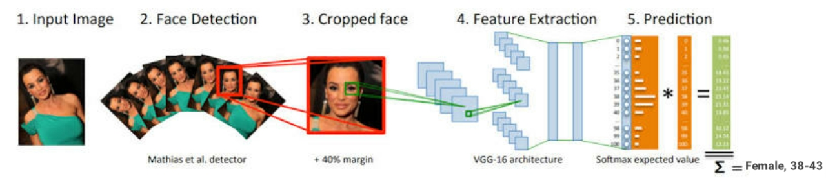
2. Convolutional neural networks(cnn)
A Convolutional Neural Network is a deep neural network (DNN) widely used for the purposes of frame recognition and processing and NLP. Also known as a ConvNet, a CNN has input and output layers, and multiple hidden layers, many of which are convolutional. In a way, CNNs are regularized multilayer perceptrons.
The convolutional neural network for this python project has 3 convolutional layers:
Convolutional layer; 96 nodes, kernel size 7
Convolutional layer; 256 nodes, kernel size 5
Convolutional layer; 384 nodes, kernel size 3
It has 2 fully connected layers, each with 512 nodes, and a final output layer of softmax type.
1. A first fully connected layer that receives the output of the third convolutional layer and contains 512 neurons, followed by a ReLU and a dropout layer.
2. A second fully connected layer that receives the 512- dimensional output of the first fully connected layer and again contains 512 neurons, followed by a ReLU and a dropout layer.
3. A third, fully connected layer which maps to the final classes for age or gender.

Slide 7

3. TensorFlow
TensorFlow is an end-to-end open source platform for machine learning. TensorFlow is a rich system for managing all aspects of a machine learning system. . TensorFlow allows developers to create dataflow graphs—structures that describe how data moves through a graph, or a series of processing nodes. Each node in the graph represents a mathematical operation, and each connection or edge between nodes is a multidimensional data array, or tensor. The single biggest benefit TensorFlow provides for machine learning development is abstraction. Instead of dealing with the nitty-gritty details of implementing algorithms, or figuring out proper ways to hitch the output of one function to the input of another, the developer can focus on the overall logic of the application. TensorFlow takes care of the details behind the scenes.
For face detection, we have a .pb file- this is a protobuf file (protocol buffer); it holds the graph definition and the trained weights of the model. We can use this to run the trained model. And while a .pb file holds the protobuf in binary format, one with the .pbtxt extension holds it in text format. These are TensorFlow files.

Slide 8
Flow chart
Start
Image
Acquisition
Face Detection
Feature Extraction
Convolution Neural Network
Trained Database
Support Vector Machine
Final Output
(Display)

Slide 9
Steps involved in FACe recognition
Detect faces : When given a frame/video, the CNN algorithm first detects for faces in each frame.
Classify into Male/Female : Once it finds faces in the frame, the features of the faces are extracted, and the gender is determined using second layer of CNN.
Classify into one of the 8 age ranges :In the third layer of CNN, the age of the faces is determined and falls under either of the 8 age ranges [ (0 – 2), (4 – 6), (8 – 12), (15 – 20), (25 – 32), (38 – 43), (48 – 53), (60 – 100)]
Put the results on the frame and display it : the result is displayed on the frame containing the age range and gender using OpenCV. The resulting frame consists of a square box around the faces with the estimated gender and age.

Slide 10
procedure
→The Dataset
For this python project, we’ll use the Adience dataset; the dataset is available in the public domain and you can find it. For this python project, we’ll use the Adience dataset; the dataset is available in the public domain and you can find it here. This dataset serves as a benchmark for face photos and is inclusive of various real-world imaging conditions like noise, lighting, pose, and appearance.
The images have been collected from Flickr albums and distributed under the Creative Commons (CC) license. It has a total of 26,580 photos of 2,284 subjects in eight age ranges (as mentioned above) and is about 1GB in size.
The models we will use have been trained on this dataset This dataset serves as a benchmark for face photos and is inclusive of various real-world imaging conditions like noise, lighting, pose, and appearance.
The images have been collected from Flickr albums and distributed under the Creative Commons (CC) license. It has a total of 26,580 photos of 2,284 subjects in eight age ranges (as mentioned above) and is about 1GB in size. The models we will use have been trained on this dataset.
We use the argparse library to create an argument parser so we can get the frame argument from the command prompt. We make it parse the argument holding the path to the frame to classify gender and age for.
For face, age, and gender, initialize protocol buffer and model.
Initialize the mean values for the model and the lists of age ranges and genders to classify from. Now, use the readNet() method to load the networks. The first parameter holds trained weights and the second carries network configuration.
We make a call to the highlightFace() function with the faceNet and frame parameters, and what this returns, we will store in the names resultImg and faceBoxes. And if we got 0 faceBoxes, it means there was no face to detect.

Slide 11
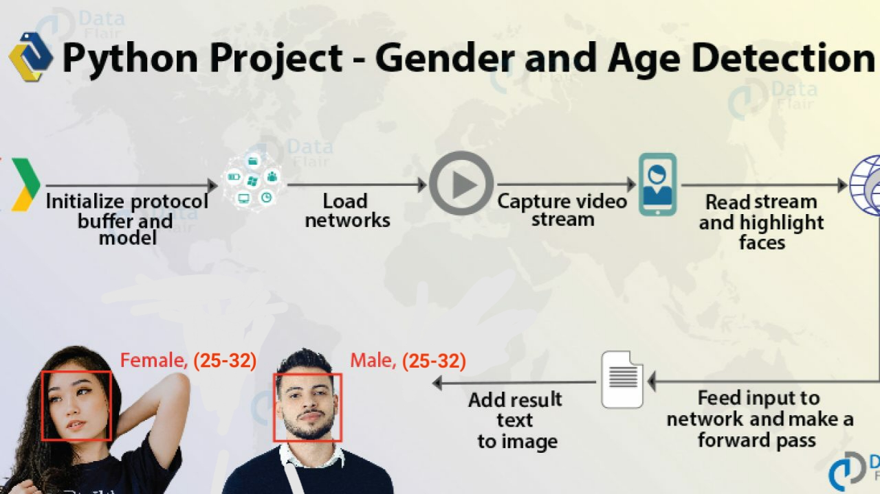
Procedure(cont.)
→ But if there are indeed faceBoxes, for each of those, we define the face, create a 4-dimensional blob from the frame. In doing this, we scale it, resize it, and pass in the mean values.
→ We feed the input and give the network a forward pass to get the confidence of the two class. Whichever is higher, that is the gender of the person in the picture.
Then, we do the same thing for age. We’ll add the gender and age texts to the resulting frame and display it with imshow().

Slide 12
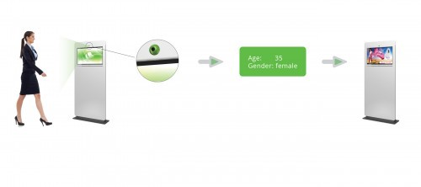
applications
Quividi which is an AI software application which is used to detect age and gender of users who passes by based on online face analyses and automatically starts playing advertisements based on the targeted audience.
Human gender and age recognition is an emerging application for intelligent video analysis.
In the forensic field, where often only the description of a suspect is available, usually the data that is always available are the gender and an age range, which would be very useful in reducing the list of candidates to be compared with the sketch to get the answers to be more precise.

Slide 13
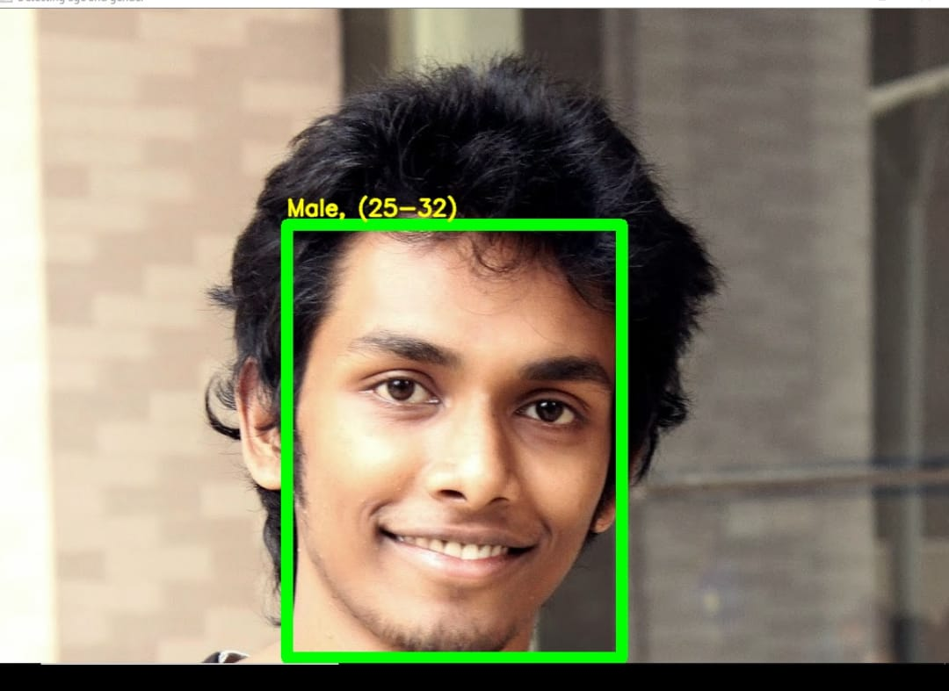

Expected result
+ our model→
Input frame
Output

Slide 14
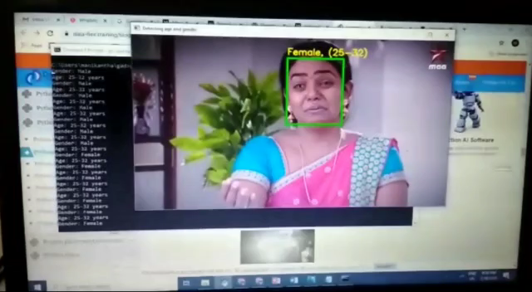



Video output

Slide 15
conclusion
Though many previous methods have addressed the problems of age and gender classification, until recently, much of this work has focused on constrained images taken in lab settings. Such settings do not adequately reflect appearance variations common to the real-world images in social websites and online repositories. The easy availability of huge image collections provides modern machine learning based systems with effectively endless training data, though this data is not always suitably labeled for supervised learning.
Two important conclusions can be made from our results. First, CNN can be used to provide improved age and gender classification results, even considering the much smaller size of contemporary unconstrained image sets labeled for age and gender. Second, the simplicity of our model implies that more elaborate systems using more training data may well be capable of substantially improving results beyond those reported here.
Overall, I think the accuracy of the models is decent but can be improved further by using more data, data augmentation and better network architectures. One can also try to use a regression model instead of classification for Age Prediction if enough data is available.

Slide 16
Future scope
Some future improvements can be made to this project. To improve the accuracy, a dataset with more number of images can be given.
The algorithm can be improved to an extent where it can be able to process and give the desired result on images with disturbances like lack of clarity, a different angle, or any kind of accessories on the face. For example, if the person is wearing sunglasses, or has makeup on the face, the algorithm will be able to give the desired result.

Slide 17

Thank you!

